Slide 1
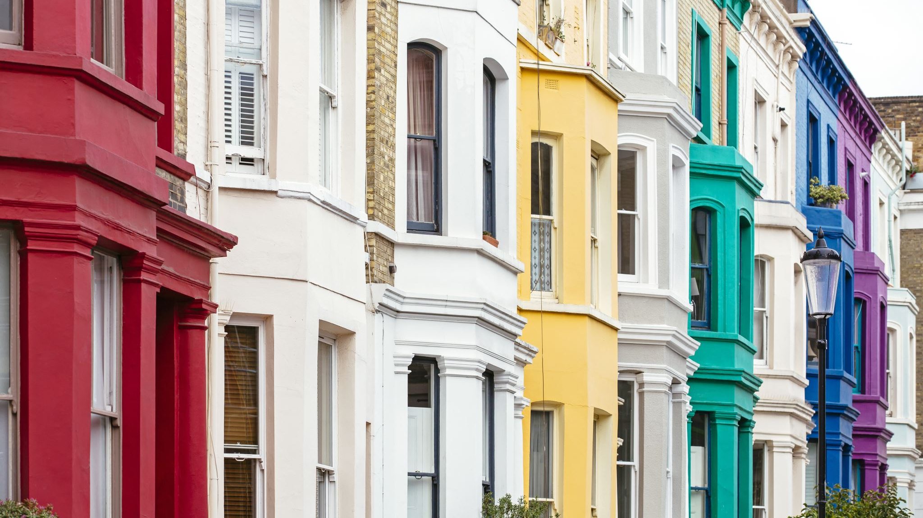
London Housing Price
Botong Miao

Slide 2
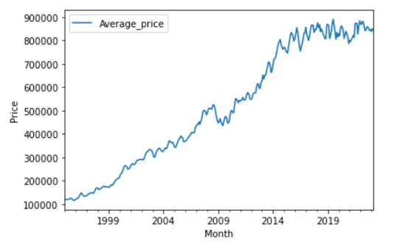
The Trend of the Average Price of Each Borough
We check the average price of each borough (e.g., Camden)
The average price increase from 1995 to 2008, and after a slight drop from 2009 to 2010, it increases until 2014. After 2014, the price becomes relatively stable.
We can use the ratio of price in 2018 to 1998 to representing the change of the average price.

Slide 3
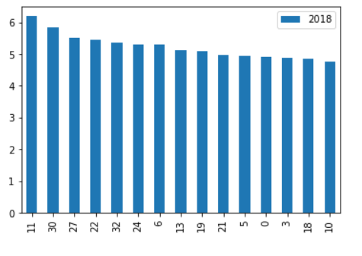
Which Borough of London Has Seen the Greatest Average Increase in Housing Prices Over the Two Decades?
We calculate the ratio between 2018 and 1998 to check the increase rate.
We list the top 15 boroughs which have the highest average housing price increase.
Hackney has seen the greatest average increase in housing prices over the two decades (the price increases by over 6 times.).
The 15th one is Greenwich where the housing price increase by 4.8 times from 1998 to 2018.

Slide 4
Techniques
Sourcing and Loading
We import the pandas, numpy libraries, and load pyplot collection of functions from matplotlib.
Our data comes from the London Datastore (https://data.london.gov.uk/).
Our data has 340 rows and 49 columns
Cleaning, Transforming, and Visualizing
We set borough name as the index and time as the row headline
We remove the rows with missing values (the row ‘Unnamed 34’ and ‘Unnamed 47’)
We use line plot to check the data quality and see the trend of price change

Slide 5

Techniques
Modeling
We use the ratio of the average price in 2018 (y2018) to the average price in 1998 (y1998) to represent the price change. The higher the ratio is the price increase larger.
The top 15 borough are: Hackney, Waltham Forest, Southwark, Lewisham, Westminster, Newham, City of London, Haringey, Kensington & Chelsea, Lambeth, Camden, Barking & Dagenham, Brent, Islington, and Greenwith.
$$df_{Ratio}=\frac{y2008}{y1998}$$

Slide 6
The Main Challenges
The main challenge I encounter is to create what kind of model to compare the price change of each Borough. In other words, how to make a clear model to show the average increase. I plot the average price change over the decades of the Borough to see the trend, and I find the price has an increase trend during this 2 decades. This means that I can use the ratio of the price in 2018 to the price in 1998 to represent the price change of each Borough. Then, I can use the histogram to compare the average price change, because it is really clear to see the price increase for every Borough.

Slide 7
Outlook
For Camden, the price becomes relatively stable after 2014. Why the price do not increase after 2014. What impact the price? The future work should check the features that impact the price to make sure the average price for each Borough is reliable.

